Slide 1

Department of Computer Science And Engineering
CMR TECHNICAL CAMPUS
(UGC Autonomous)
2020-2023
Mini Project
SECURE CRYPTO-BIOMETRIC SYSTEM FOR CLOUD COMPUTING
Under the Guidance of
V. NARESH KUMAR
(Associate Professor)
BY
SARA : 207R1A05N8
ANUMULA ABHITEJ REDDY : 207R1A05J7

Slide 2
ABSTRACT
Cloud computing has matured and now boasts a diverse range of providers and services. However, security concerns continue to hinder widespread user acceptance.
Biometric technologies are increasingly important for secure identification and verification, but managing biometric data in the cloud presents challenges due to privacy regulations and the need for trust.
To address these challenges, we propose a crypto biometric system for cloud computing that eliminates the need to expose private biometric data.

Slide 3
EXISTING SYSTEM
Two methods for generating cryptographic keys from biometric data: direct creation of a binary key and combination of stored biometric data with a random binary sequence.
Key binding systems can secure a biometric template using a binary key or release a cryptographic key only when a legitimate biometric trait is presented.
Error correcting codes (ECCs) and feature transformation techniques can manage intra-class variability of biometric templates and address vulnerabilities in fuzzy commitment systems.

Slide 4
EXISTING SYSTEM DISADVANTAGES
Less Accuracy
Low Efficiency
Privacy Concerns
High Cost

Slide 5
PROPOSED SYSTEM
The templates are stored in a database but template protection is not addressed.
A cloud private matching identification algorithm is proposed in , but it does not include a mechanism to renew the biometric templates.
The schema in employs cryptography to protect the templates that are stored in the cloud, but it does not consider the issue of data location, which could lead to a breach of data protection laws.

Slide 6
PROPOSED SYSTEM ADVANTAGES
High Accuracy
High Efficiency
Enhanced Security
Convenience
Cost-Effective

Slide 7
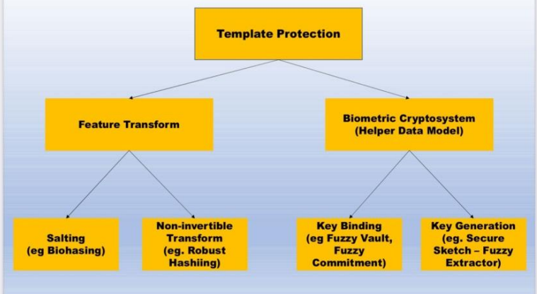
SYSTEM ARCHITECTURE

Slide 8
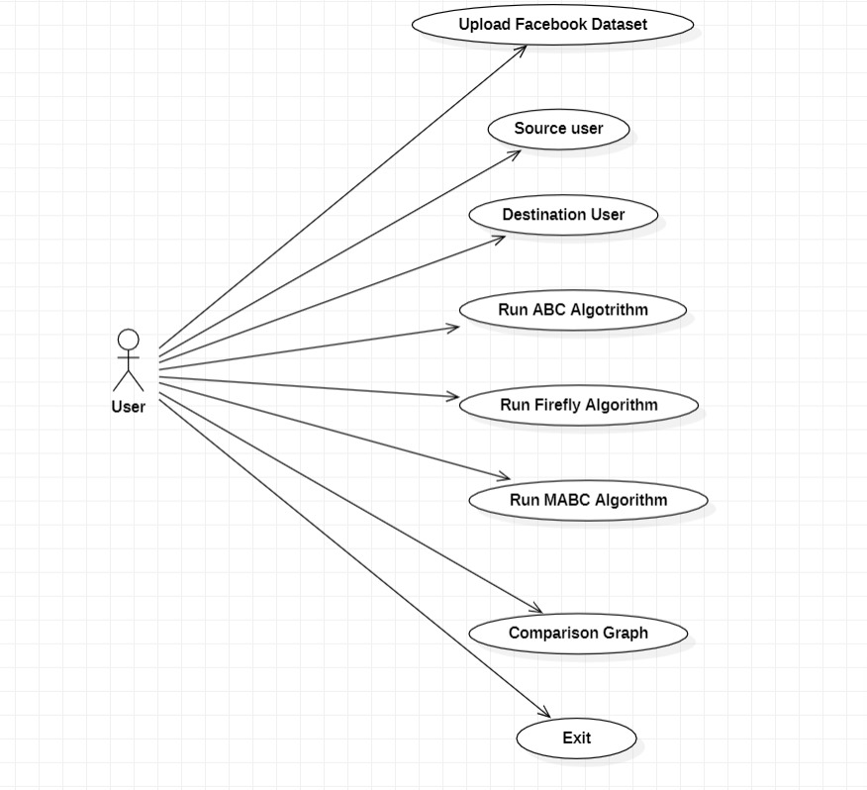
Use case diagram

Slide 9
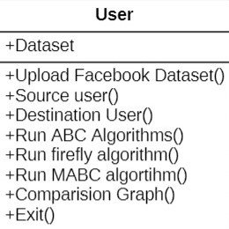
Class diagram

Slide 10
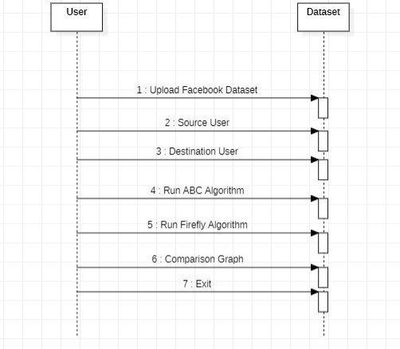
Sequence diagram

Slide 11
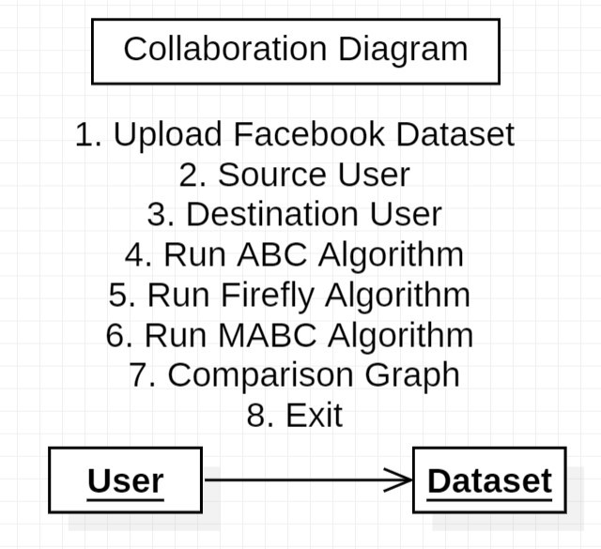
Collaboration Diagram

Slide 12
HARDWARE REQUIREMENTS
System : i3 and above
Ram : 4 GB and above
Hard Disk : 40 GB and above

Slide 13


SOFTWARE REQUIREMENTS
Operating system : Windows8 and Above.
Coding Language : python 3.6

Slide 14
NOVELTY
Integration of biometric authentication: A secure crypto-biometric system for cloud computing should integrate biometric authentication methods to enhance security.
Biometric authentication methods can include fingerprints, facial recognition etc.
Strong encryption: The system should use strong encryption techniques to protect sensitive data during storage and transmission. Robust access control: A robust access control system should be in place to limit access to sensitive data. This can include multi-factor authentication, and continuous monitoring of user activities.

Slide 15
CONCLUSION
A biometric system for cloud computing enhances security compared to traditional authentication methods.
It uses unique biometric features like fingerprints, iris scans, or facial recognition to ensure only authorized users can access sensitive data.
The system improves convenience by eliminating the need for passwords or other difficult-to-manage credentials.
The system can adapt to different user needs, such as providing multiple authentication options for users with disabilities or unique physical characteristics.

Slide 16
THANK YOU

